Slide 1
Cloud Computing Architectures

Slide 2
In start , a utility service
Cloud in general, datacenter, a collection of clusters, or a heterogeneous distributed system composed of desktop PCs, workstations, and servers.

Slide 3
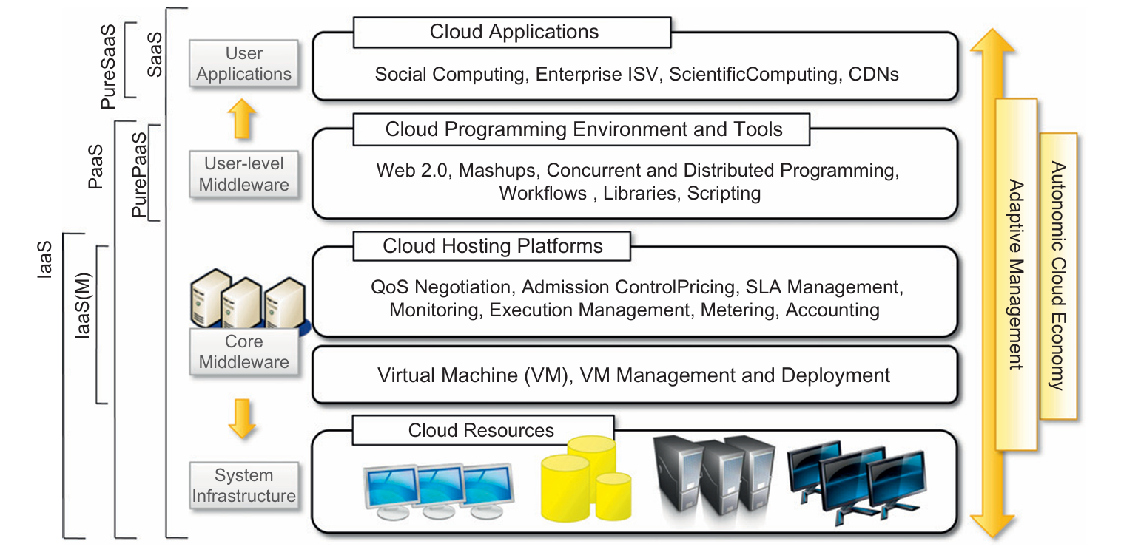
The Cloud Reference Model

Slide 4
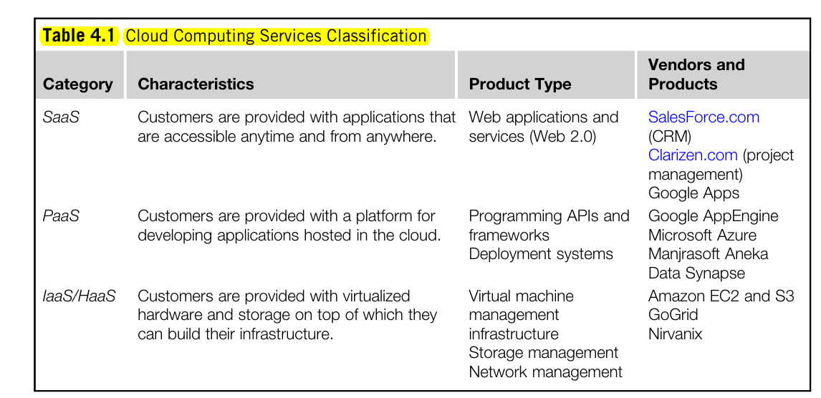
Cloud Computing Services
The combination of hosting platforms and resources is generally called IaaS
The range of tools include Web-based interfaces, command-line tools, and frameworks for concurrent and dis tributed programming.
Pure PaaS ?
XaaS ?

Slide 5
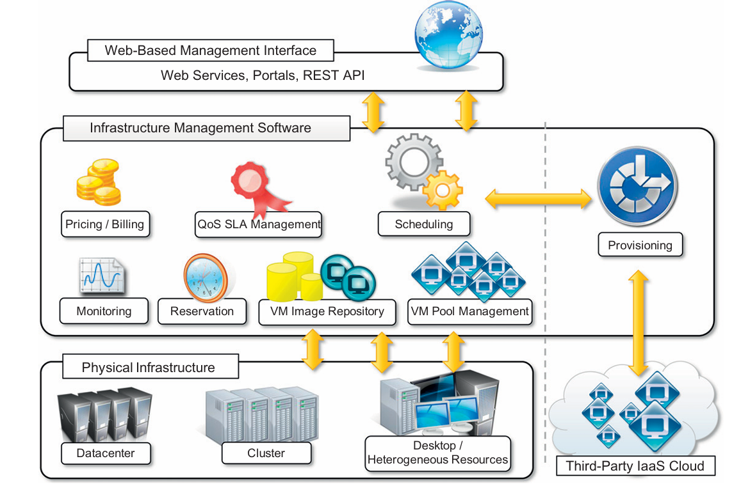
IaaS
Single server offering entire infrastructure, network devices, load balancers, databases, web servers.

Slide 6
Cloud Computing at Amazon
Earlier, installed infrastructure for selling variety of goods.
Mid 2000, amazon web services AWS
offers an infrastructure consisting of compute and storage servers interconnected by high-speed networks that support a set of services to access these resources.
Role of application developer ?
EC2. Elastic Computing Cloud, Web service with a simple interface for launching instances of an application under several operating systems.
An instance created from Amazon Machine Image (AMI) stored in S3, or user define image.
Image includes, OS, runt time environment , libraries, application.

Slide 7
EC2:
Launch an instance from an existing AMI and terminate an instance
Start and stop an instance
create a new image
add tags to identify an image
reboot an instance.
Based on Xen virtualization.
User interaction with SOAP messages.
User has root access so he can relocate the instance.
VM import, user environment
Elastic load Balancing, distribute the application traffic
Elastic IP address.

Slide 8
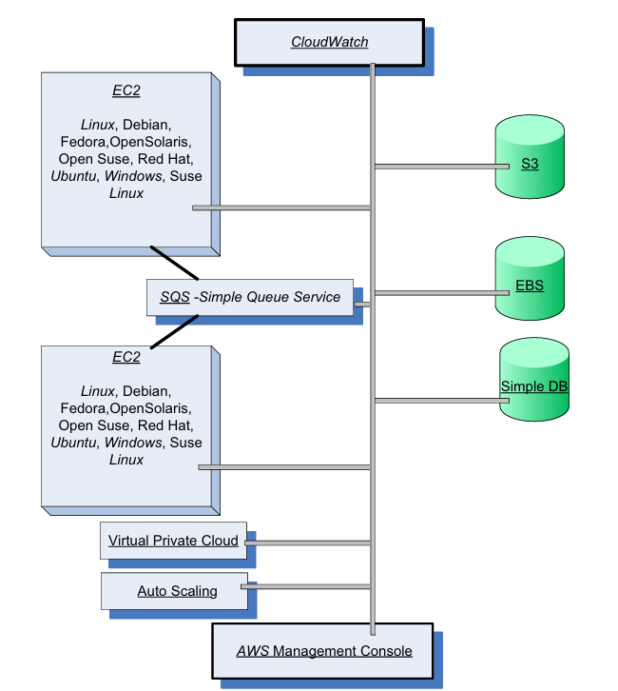
S3

Slide 9
Amazon Web Services
Simple Storage System (S3): storage for large objects from byte to Terabytes,
with primitive functions write, read, delete, put, get excluding copy, rename and move.
Object stored in bucked and retrieved with Dev-key.
Elastic Bucket Store (EBS): persistent block-level storage for EC2 instance,
volume is raw, unformatted and reliable physical disk from 1 GBt to 1 TB or even more.
Volume from same zone grouped and replicated in each zone, instance can have multiple volume, but volume can not be shared with multiple instances.
Good for database application , file systems application with raw data devices
Simple Db: a nonrelational data store that allows developers to store and query data items via Web services requests.
supports store-and-query functions traditionally provided only by relational databases.
Creates multiple geographically distributed copies of each data item and supports high-performance Web applications

Slide 10
Amazon Web Services
Simple Queue Service (SQS): hosted message queue.
SQS is a system for supporting automated workflows
allows multiple Amazon EC2 instances to coordinate their activities by sending and receiving SQS messages.
Any computer connected to the Internet can add or read messages without any installed software or special firewall configurations.
Applications using SQS can run independently and asynchronously and do not need to be developed with the same technologies.
A received message is “locked” during processing; if processing fails, the lock expires and the message is available again.
CloudWatch:
monitoring infrastructure used by application developers, users, and system administrators
collect and track metrics important for optimizing the performance of applications and for increasing the efficiency of resource utilization.
Without installing any software, a user can monitor approximately a dozen preselected metrics and then view graphs and statistics for these metrics.
Default is free of cost, detailed monitoring is subject to charge,

Slide 11
Amazon Web Services
Elastic Beanstalk:
service that interact with other AWS services, including EC2, S3, Elastic load balancing , auto scaling
automatically scales the resources as required by the application, either up, or down based on default Auto Scaling settings.
Some of the management functions provided by the service are:
deployment of a new application version (or rollback to a previous version);
access to the results reported by CloudWatch monitoring service;
email notifications when application status changes or application servers are added or removed;
Simple application can also be managed via this services:
For example, a Java developer can create the application using any Integrated Development Environment (IDE) such as Eclipse and package the code into a Java Web Application Archive (a file of type “.war”) file. The “.war” file should then be uploaded to the Elastic Beanstalk using the Management Console and then deployed, and in a short time the application will be accessible via a URL. (Assignment #1)

Slide 12
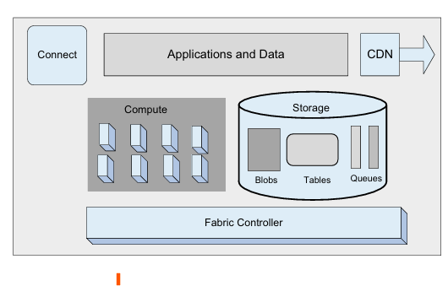
Microsoft Windows Azure

Slide 13
Azure services
PaaS and SaaS cloud platform.
Three core components:
Compute: provides computation environment to run application
an application typically runs multiple instances of a role.
Web role instances used to create Web applications; (queue)
Worker role instances used to run Windows-based code;
VM role instances that run a user-provided Windows Server (blobs)
Storage: scalable storage uses , blobs, tables and queues to store data,
Blob: contain binary data( a container consists of one or more blobs, ), and its has metadata
Fabric Controller : deploy, manages and monitors applications
Connect : allow IP connection between user system and user application which is deployed at Azure.
Content Delivery Network (CDN): maintain cache copies of data to speed up computation

Slide 14
Google Computing:
What type of cloud services does google offer ? Hostel Task

